Slide 1
Strings

Slide 2
Strings
Strings are used to store and manipulate text.
Strings are the sequence of character enclosed within the single quotes(‘), double quotes(“), or backticks(`)
Strings can be created using the following the syntax
let name1 = “John”;
let name2 =‘Abin’;
let name3 =`Vrindha`

Slide 3
Template literals
Template literals use backticks instead of quotes to define a string
let name=`John`
With template literals ,It is possible to use both single as well as double quotes inside a string
let sentence=`The name “is” Hari’s `
We can insert variables directly in template literals this is called String interpolation
let a= `This is ${name}` //prints This is Hari

Slide 4
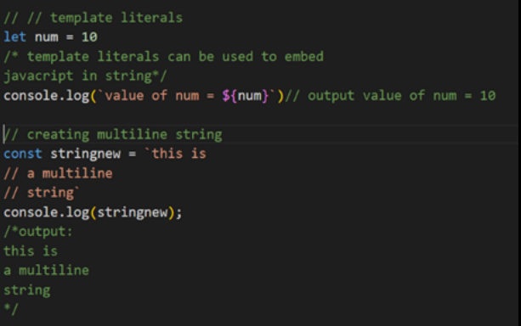
Template literals

Slide 5
Escape Sequence Characters
let text = “This is my “new" car.";//error
JavaScript will misunderstand this string:
The solution to avoid this problem, is to use the backslash escape character.
The backslash (\) escape character turns special characters into string characters:
let text = " This is my \" new \" car.";
let text = "The character \\ is called backslash.";

Slide 6
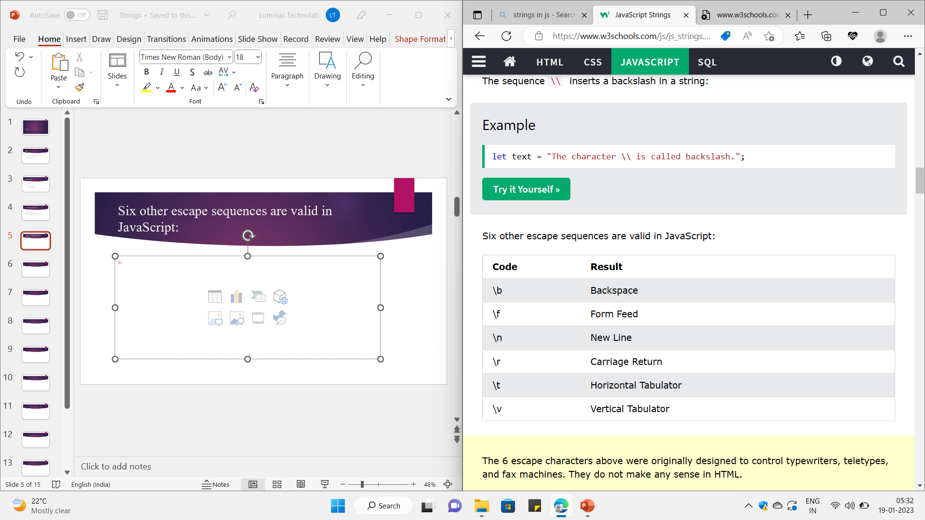
Six other escape sequences are valid in JavaScript:

Slide 7
String concatenation
We can concatenate two or more string using ‘+’ symbol
We Already discussed in the previous class.

Slide 8
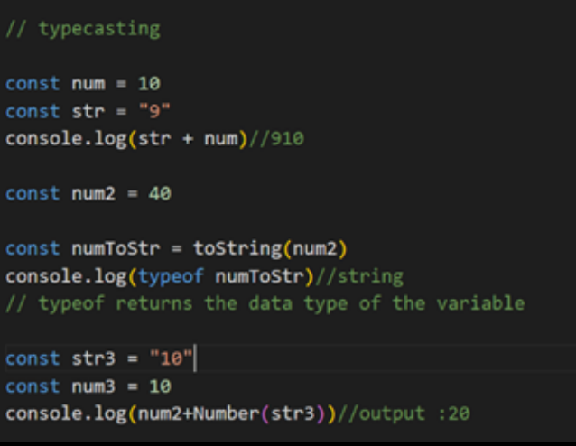
Type casting
Number will be typecast into string we can also use toString() to change Number into String Number() can be used to change string to Number

Slide 9
String Properties and Methods
let sname = "Manu"
console.log(sname.length); //Prints the length of the string 4
console.log(sname.toUpperCase());//prints MANU
console.log(sname.toLowerCase());//prints manu

Slide 10
Access String Characters
You can access the characters in a string in two ways.
1. One way is to treat strings as an array. For example,
const a = 'hello’;
console.log(a[1]); // "e“
2. Another way is to use the method charAt(). For example,
const a = 'hello’;
console.log(a.charAt(1)); // "e"

Slide 11
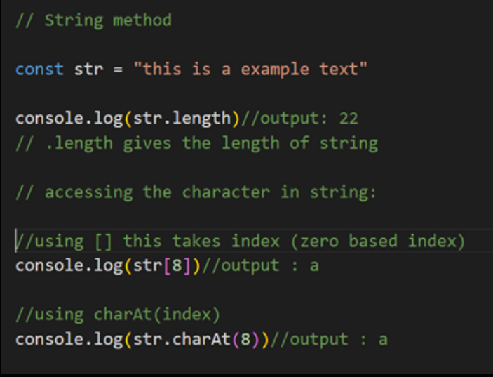





Slide 12
1. concat()
It used to add or join multiple strings to one string. When we need to add one more than string, we can use it.
oneString.concat(‘separator’, anotherString)

Slide 13
Example:
const firstName = "Jhon";
const lastName = "Doe";
const title = "2nd";
// Concatenation between two String.
const twoStr = firstName.concat(' ', lastName);
console.log(twoStr); // expected output: Jhon Doe
// Concatenation among three String.
const threeStr = firstName.concat(' ', lastName,' ', title);
console.log(threeStr); // expected output: Jhon Doe 2nd
// feel free to use ' ', '+', ',' what you want as string separator.

Slide 14
2. includes()
includes() is used for checking a selected string elements or characters from a string, it would be a word also. And If it gets the targeted thing, it returns true otherwise returns false.
string.includes(‘string characters’, string)

Slide 15
Example:
const string = "JavaScript is cool";
const lang = "JavaScript";
string.includes(lang) ? console.log(true) : console.log(false);
// expected output: true
// we can check only one characters or more than one. For Example:
string.includes('J') ? console.log(true) : console.log(false);
// expected output: true
string.includes('Java') ? console.log(true) : console.log(false);
// expected output: true
string.includes('java') ? console.log(true) : console.log(false);
// expected output: false // It's case-sensitive also.

Slide 16
3. split()
split() used to separate or divide string by on the basis of different types of separators like ‘ ‘ or comma and what you want. It’s important to keep in mind that it returns an array as output.

Slide 17
const personName = "Jhon Doe";
const splitPersonName = personName.split(' ');
console.log(splitPersonName); // expected output: [ 'Jhon', 'Doe' ]
const greetings = 'hi, hey, hello';
const splitGreetings = greetings.split(', ');
console.log(splitGreetings);
// expected output: [ 'hi', 'hey', 'hello' ]

Slide 18
4. slice()
If you want to copy a string by value not copy by reference, the slice() method is going solution to you. You can change or do anything with copied string but the previous string will remain unchanged.
string.slice(‘startsIndex’, ‘endsIndex’)

Slide 19
const string = "JavaScript is Beauty." const sliceString = string.slice(0, 11) console.log(sliceString); // expected output: JavaScript

Slide 20
5. charAt()
It returns a string character according to the index of string. If you need to know a specific string character providing the string index, you can easily grab it by using that cool method.
string.charAt(index)

Slide 21
const string = 'John Doe';
const gotChar = string.charAt(2);
console.log(gotChar); // expected output: h
const anotherChar = string.charAt(0);
console.log(anotherChar); // expected output: J

Slide 22
6. subStr()
subStr method is used to get a portion of the string. It gives two arguments. one is for start index and another is for length. If you gave only one argument, that would be taken as a starting index, the last index of string would be taken automatically as the length.
string.subStr(startsIndex, length);

Slide 23
const string = 'This is a simple text';
const gotText = string.substr(9, 7);
console.log(gotText); // expected output: simple
const anotherText = string.substr(9);
console.log(anotherText); // expected output: simple text

Slide 24
7. trim()
trim() is one of the cool functions of string in javascript. It used to remove extra white spaces both starting and ending point of the string.
We can also use trimStart() to remove white spaces at the starting point and trimEnd() to remove white spaces at the ending point.
string.trim() string.trimStart(); string.trimEnd();

Slide 25
const name = ' John Doe ';
const trimName = name.trim();
console.log(trimName); // expected output: John Doe
const age = ' 32';
const trimAtStart = age.trimStart();
console.log(trimAtStart); // expected output: 32
const address = 'Chittagong ';
const trimAtEnd = address.trimEnd();
console.log(trimAtEnd); // expected output: Chittagong

Slide 26
8. startsWith() & endsWith()
statsWith() is used for matching string character or characters at the starting point of a certain string. On the other hand, endsWith() is used for matching ending character or characters at the ending point of a certain string.
string.endsWith(chars); string.startsWith(chars);

Slide 27
const greeting = "Hi, John";
greeting.startsWith('Hi') ? console.log("True") : console.log("False");
// expected output: true;
greeting.startsWith('H') ? console.log("True") : console.log("False");
// expected output: true;
greeting.endsWith('n') ? console.log("True") : console.log("False");
// expected output: true;
greeting.endsWith('John') ? console.log("True") : console.log("False");
// expected output: true;
greeting.endsWith('john') ? console.log("True") : console.log("False");
// expected output: false; // Because, It's case-sensetive

Slide 28
10 Most Important String Methods in JavaScript For Everyday Use | by Nazmul Hoque | Medium

Slide 29
String Properties and Methods
let name1 ="Ann M"
let newname = name1.replace("M","Luka")
console.log(name1); //Ann M
console.log(newname);//Ann Luka
let s_name ="Sagar"
let m_name="Alias"
let l_name="Jacky"
let full_name=s_name.concat(m_name+l_name)
console.log(full_name);//SagarAliasJacky

Slide 30
String Properties and Methods
Removes whitespace from the beginning and end of a string.
let str = " Hello, World! ";
let trimmedStr = str.trim();
console.log(trimmedStr); // Outputs: "Hello, World!"

Slide 31
Tasks
1 What will be output the following print statement in js
console.log("hari\"".length) 2 Explore the includes, startswith and endswith function of a string 3 Extract the amount out of the string
"Please give Rs 10000"
4 Try to Change 4th character of a given string
"Where you able to do it?"
5 Note on All string methods with programs
Continue to next slide…

Slide 32
Tasks
6 Write a function to check if two strings are anagrams of each other. Anagrams have the same characters but in a different order. For example, "listen" and "silent" are anagrams.
7 Write a function to count the number of vowels and consonants in a given string.
8 Write a function that capitalizes the first letter of each word in a sentence. For example, "hello world" should become "Hello World.“
9 Implement a function to perform basic string compression using the counts of repeated characters. For example, the string "aabcccccaaa" would become "a2b1c5a3.“
10 Implement a basic string compression without creating a separate function. Use loops and conditional statements to create the compressed string.

